Slide 1
TCS Stock Analysis & Price Prediction
Python | Time Series Analysis | Machine Learning

Slide 2
Objective of the Project:
Analyze historical stock performance of TCS
Identify price trends, volatility, and seasonality
Perform time-series analysis on closing prices
Predict next-day closing price using Machine Learning
Build a portfolio-ready analytics project

Slide 3
Data Source:
Date
Open
High
Low
Close
Volume
Divdents
stocksplit

Slide 4
Exploratory Data Analysis (EDA)
EDA Performed:
Closing price trend analysis
Trading volume analysis
Correlation analysis between price features
Moving averages (20-day & 50-day)
Purpose:
Understand market behavior
Identify long-term and short-term trends

Slide 5
Key Observations:
TCS stock shows a long-term upward trend
Short-term fluctuations observed due to market conditions
Trend analysis helps identify growth phases

Slide 6
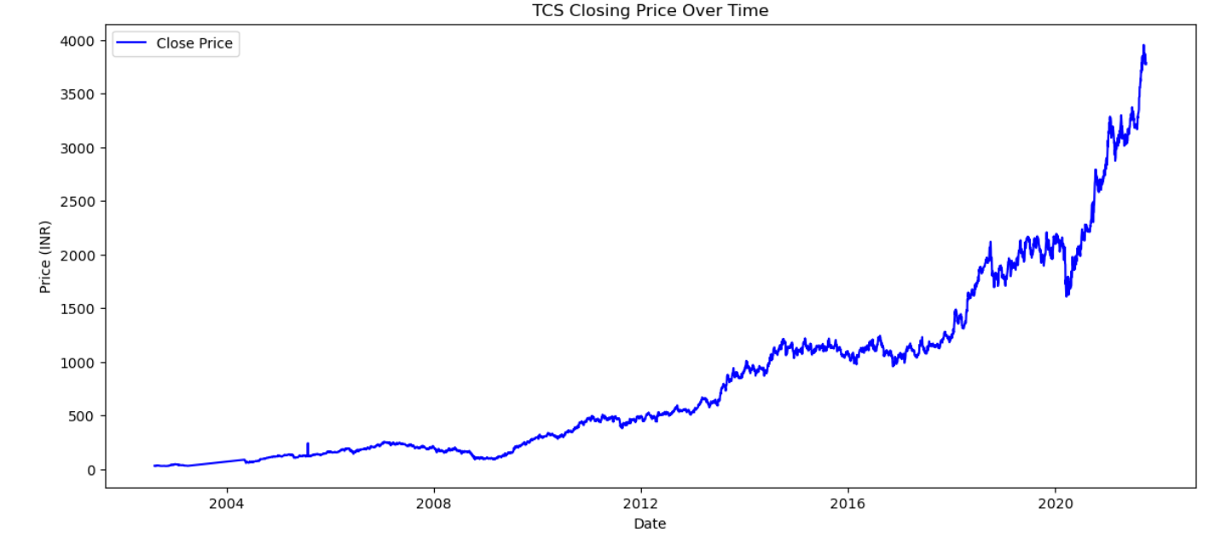
Closing Price Trend
Key Observations:
TCS stock shows a long-term upward trend
Short-term fluctuations observed due to market conditions
Trend analysis helps identify growth phases

Slide 7
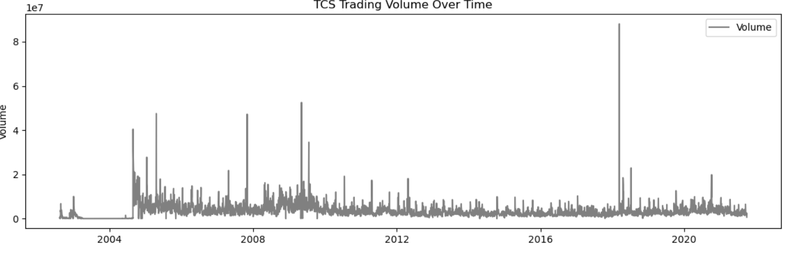
Volume Analysis
Sudden volume spikes align with major price movements
Higher trading volume indicates strong market activity
Volume helps validate price trends

Slide 8
Time Series Decomposition
Technique Used:
Monthly resampling of closing prices
Seasonal decomposition
Components Analyzed:
Trend
Seasonality
Residuals
Benefit:
Helps understand long-term patterns and cyclic behavior

Slide 9
Feature Engineering
Features Created for ML:
Open, High, Low, Close prices
Trading Volume
Lag-based target (Next-day Close Price)
Moving Averages (MA20, MA50)
Why Feature Engineering?
Improves model learning
Captures price behavior effectively

Slide 10
Machine Learning Model
Model Used:
Linear Regression
Approach:
Time-series safe train-test split (no shuffling)
Predict next-day closing price

Slide 11
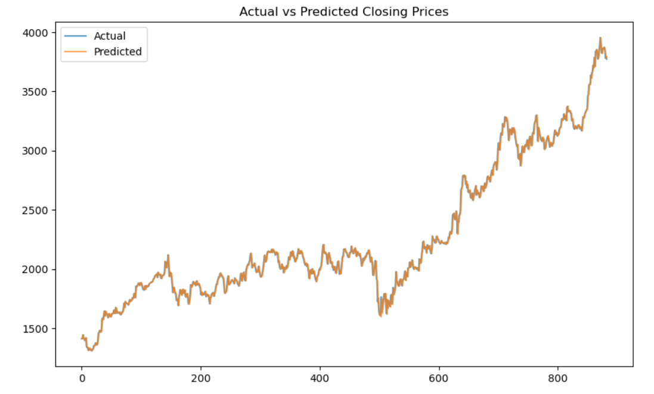
Model Evaluation
Evaluation Metrics:
RMSE (Root Mean Squared Error)
R² Score
Results:
Model provides reasonable short-term predictions
Actual vs Predicted price comparison performed

Slide 12
Business Insights:
TCS stock demonstrates consistent long-term growth
Moving averages help identify bullish and bearish phases
Volume plays a key role in validating price trends
ML model captures general price movement effectively

Slide 13
Conclusion & Future Scope
Conclusion:
Successfully completed end-to-end stock analysis
Combined EDA, time-series analysis, and ML
Strong portfolio project for data analyst roles
Future Enhancements:
Use advanced models (Random Forest, LSTM)
Add Power BI dashboard
Include more technical indicators

Slide 14
Thank you

